Slide 1
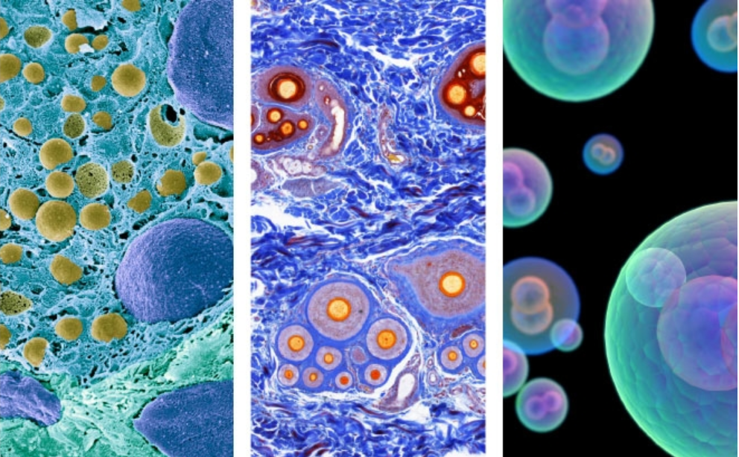
Breast Cancer Prediction Model: Benign or Malignant
Martin Garcia
Andrew L. Wilkins

Slide 2
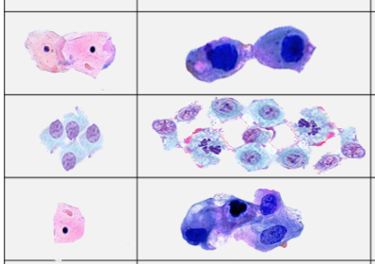
Cancer Cell
Defined by where they grow
Carcinoma
Broken cell that does not stop regenerating
We are not biologist, so we use differences in data based physical attributes of these cells

Slide 3
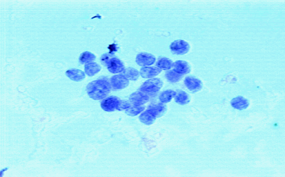
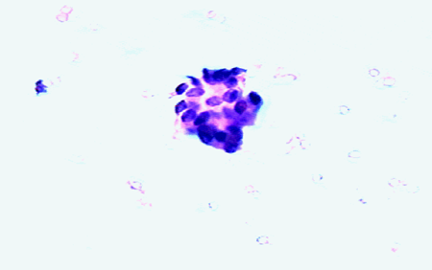
Cells
Original images captured by Dr. Wolberg at the University of Wisconsin Hospital in Madison
Total 569 observations
357 benign
212 malignant

Slide 4
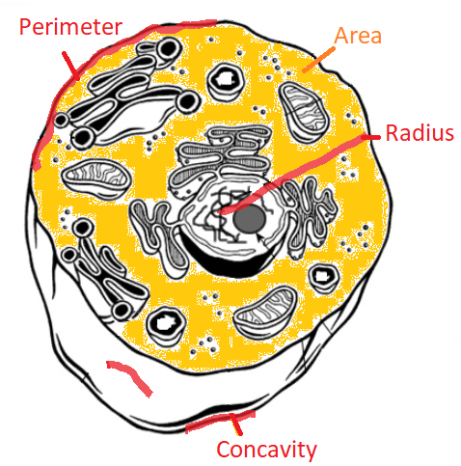
Data Description
1 binary response variable
Malignant
Benign
30 continuous variables
Physical attributes related to cell

Slide 5
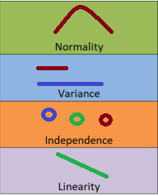
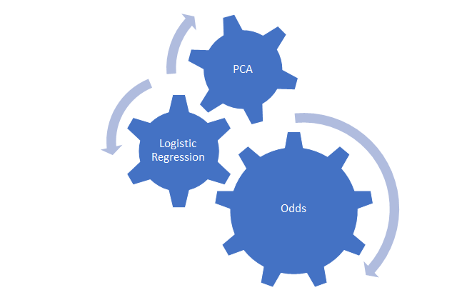
Exploratory Data Analysis
•Assumptions dictated by our test

Slide 6
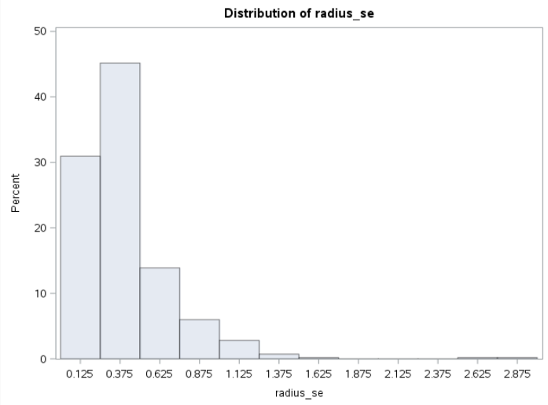
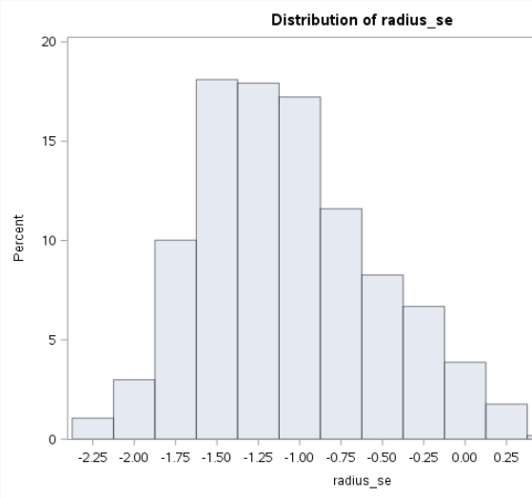
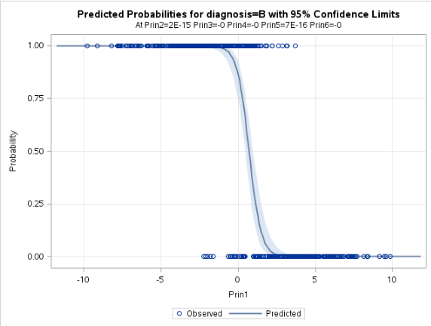
EDA - Normality
Normality
PCA | Logit
N | N
Log
Binary Response
Transform using logit link

Slide 7
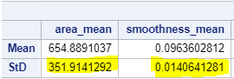
EDA - Variance
Variance
PCA | Logit
N | N
Summary Statistics
•Large variances
Binary Response
•Response has nonconstant variance
•Addressed with logit function

Slide 8




EDA- Independence and Linearity
• Independence assumed
•Assumed patients not related, other than same doctor used to collect samples
Matrix of explanatory variables linear
Linearity not met once we reduce into principle components, as a result we take natural log for odds ratio

Slide 9

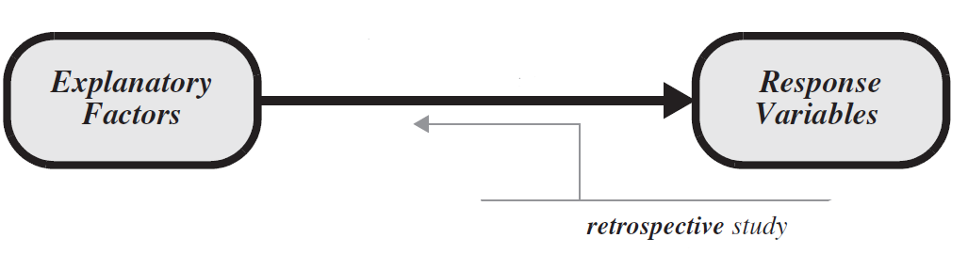
Study Type
Retrospective Study
We must look backwards and look at explanatory variables
These were cases of patients exhibiting invasive breast cancer with no evidence of spread or metastases
Use odds ratio instead of probability

Slide 10
Principle Component Analysis
PCA
Scaling required due to large variances
Want to reduce number of variables
Covariance Matrix
Correlation Matrix

Slide 11
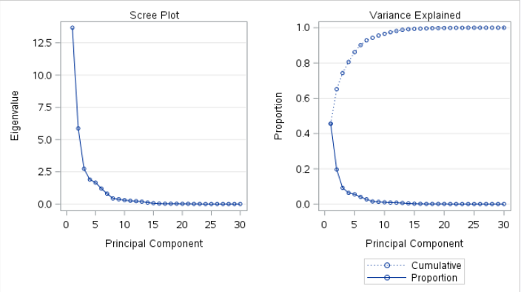
PCA
30 x Explanatory variables
6 x Variates
Reduced number of variables to help us predict cell type

Slide 12
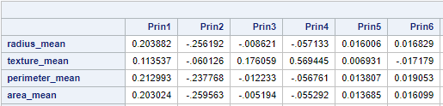
PCA
PCA
Principal components change our interpretation of our variables
PCA
Using correlation matrix we were able to evenly compare all variables, no one variable was more important

Slide 13
PCA
•Top explanatory variables per principle component
•Blue represents positive loadings
•Red represents negative loadings
•Example: Prin1
Emphasizes concavity

Slide 14
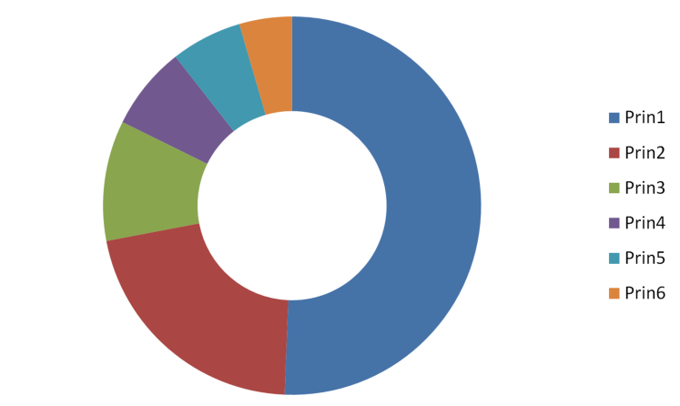

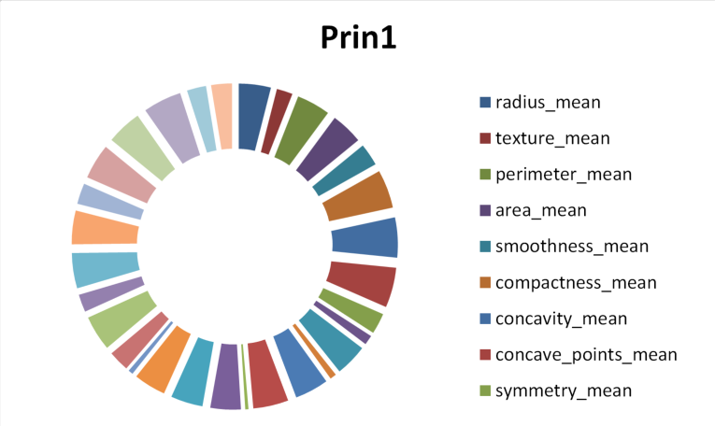
Translating PCA
Results require translation of loadings
Probability = Prin1 Prin2 Prin3 Prin4
Answer not as intuitive

Slide 15
Logistic Regression
Retrospective study
Odds or Probability
Binary response variable
Logistic regression or least discriminant analysis

Slide 16
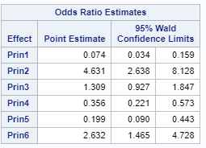

Translating Logistic Regression
Odds ratios help us compare odds of malignancy or benign holding all other variables constant
Due to PCA translation is changed
Odds ratio holding all principle complonents constant
Translation example: Significant increases in odds are noticed in the 2nd principle component, indicating a one unit change in Prin2 increases the odds of benign cancer by 4.631 holding all other variates constant.

Slide 17
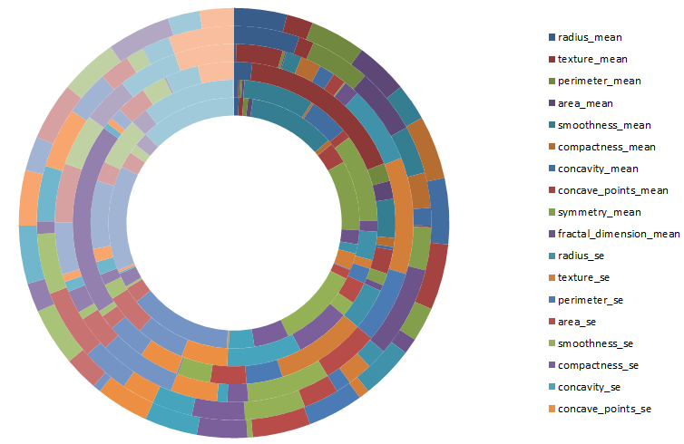
Conclusion
Big Picture
Diagram is a sum of prin
Broken down by explanatory variables

